Slide 1

Final Defence (Process Version)
What I Actually Built, Verified, and Finalized
Optimizing Agricultural Resource Allocation through Reinforcement Learning
Haider Masood (401636)
MS Artificial Intelligence
Supervisor: Dr. Zuhair Zafar
Department of Computing, NUST SEECS | March 2026
1

Slide 2
Agenda: Real Work and Real Status
AGENDA
Starting point: what existed before thesis customization
Implementation phases and what changed in each phase
Verification trail: tests, smoke runs, and generated artifacts
How to interpret old 'fresh 113-job campaign pending' text
What worked, what remains limited, and why
Next steps beyond finalized thesis evidence
Haider Masood | Process-Focused Defence Deck | March 2026
2

Slide 3
Starting Point vs Thesis Target
CONTEXT
Original Base
Thesis Target
CyclesGym core envs and training scripts
General simulator integration
No thesis-specific evidence discipline
Limited localization depth for Pakistan narrative
Pakistan-adapted weather/soil/pricing stack
NPK-aware reward and reporting support
Hierarchical planning + fertilization integration
Clear implemented-vs-future evidence policy
Haider Masood | Process-Focused Defence Deck | March 2026
3

Slide 4
What I Actually Did: 5 Implementation Phases
PROCESS
Phase 1
Phase 2
Phase 3
Phase 4
Phase 5
Pakistan crop-calendar alignment
Price localization + NPK scaffolding
Hierarchical integration
Reporting and artifact hardening
Final NPK run-readiness checks
Haider Masood | Process-Focused Defence Deck | March 2026
4

Slide 5
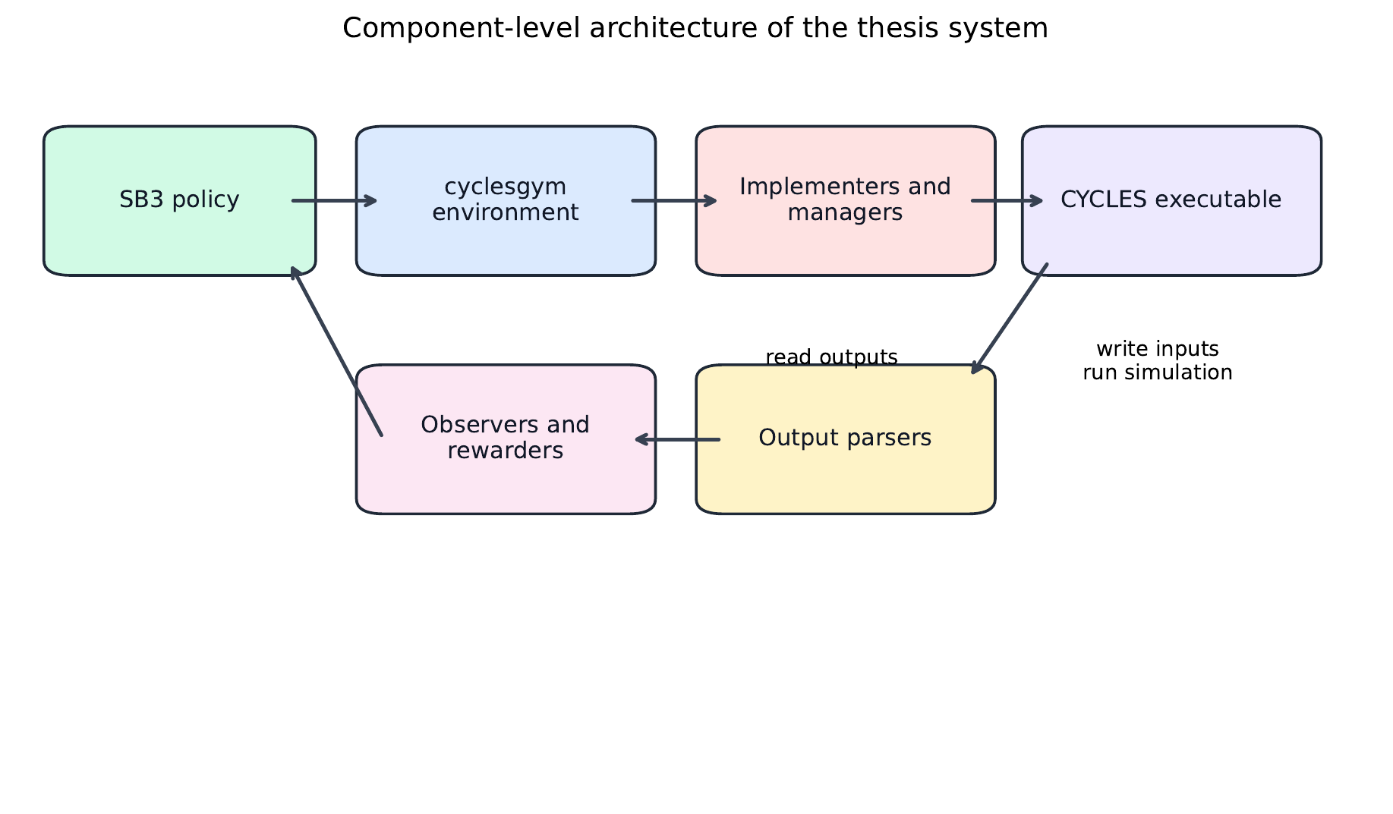
System I Ended Up Building
SYSTEM
SB3 policies drive environment actions
Environment writes simulator files and invokes CYCLES
Outputs are parsed to observations and reward components
Reporting layer captures explainable per-run artifacts
Haider Masood | Process-Focused Defence Deck | March 2026
5

Slide 6
How I Verified It Works
VERIFICATION
Passing checks (March 8, 2026)
Smoke Run Evidence
test_thesis_reporting
test_pricing_utils
test_crop_planning
test_hierarchical_env
LaTeX thesis build pipeline
offline_20260308_071804
PPO | fertilization | NPK
fixed weather | 1000 years
Deterministic: 1819.76
Stochastic mean: 1805.40
Std: 17.60
PK holdout: 1816.86
Haider Masood | Process-Focused Defence Deck | March 2026
6

Slide 7
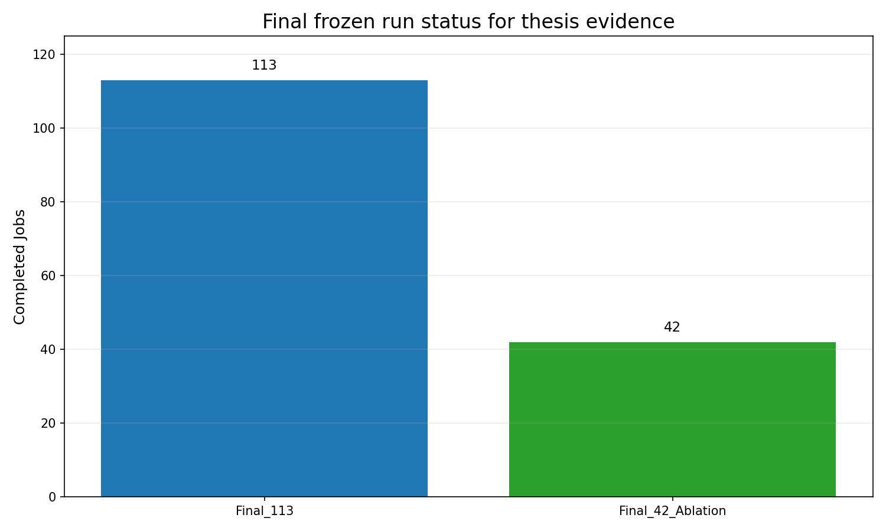
Final Matrix Status (Completed Frozen Runs)
STATUS
Numbers
Final matrix jobs in final_113: 113
Completed final_113 jobs: 113
Completed final_42_ablation jobs: 42
Frozen reporting packs generated and archived
Final broad comparison is backed by frozen completed runs.
Haider Masood | Process-Focused Defence Deck | March 2026
7

Slide 8
What This Old Phrase Means
CLARIFICATION
Old phrase: 'Fresh 113-job campaign is pending for final comparative chapter'
That statement came from an older provisional extraction snapshot.
Canonical final evidence now comes from completed final_113 and final_42_ablation folders.
Final comparative claims should be built from those frozen reporting packs.
Old pending wording should not override the finalized run directories.
Simple version: planning and full execution are both complete; use the frozen final packs.
Haider Masood | Process-Focused Defence Deck | March 2026
8

Slide 9
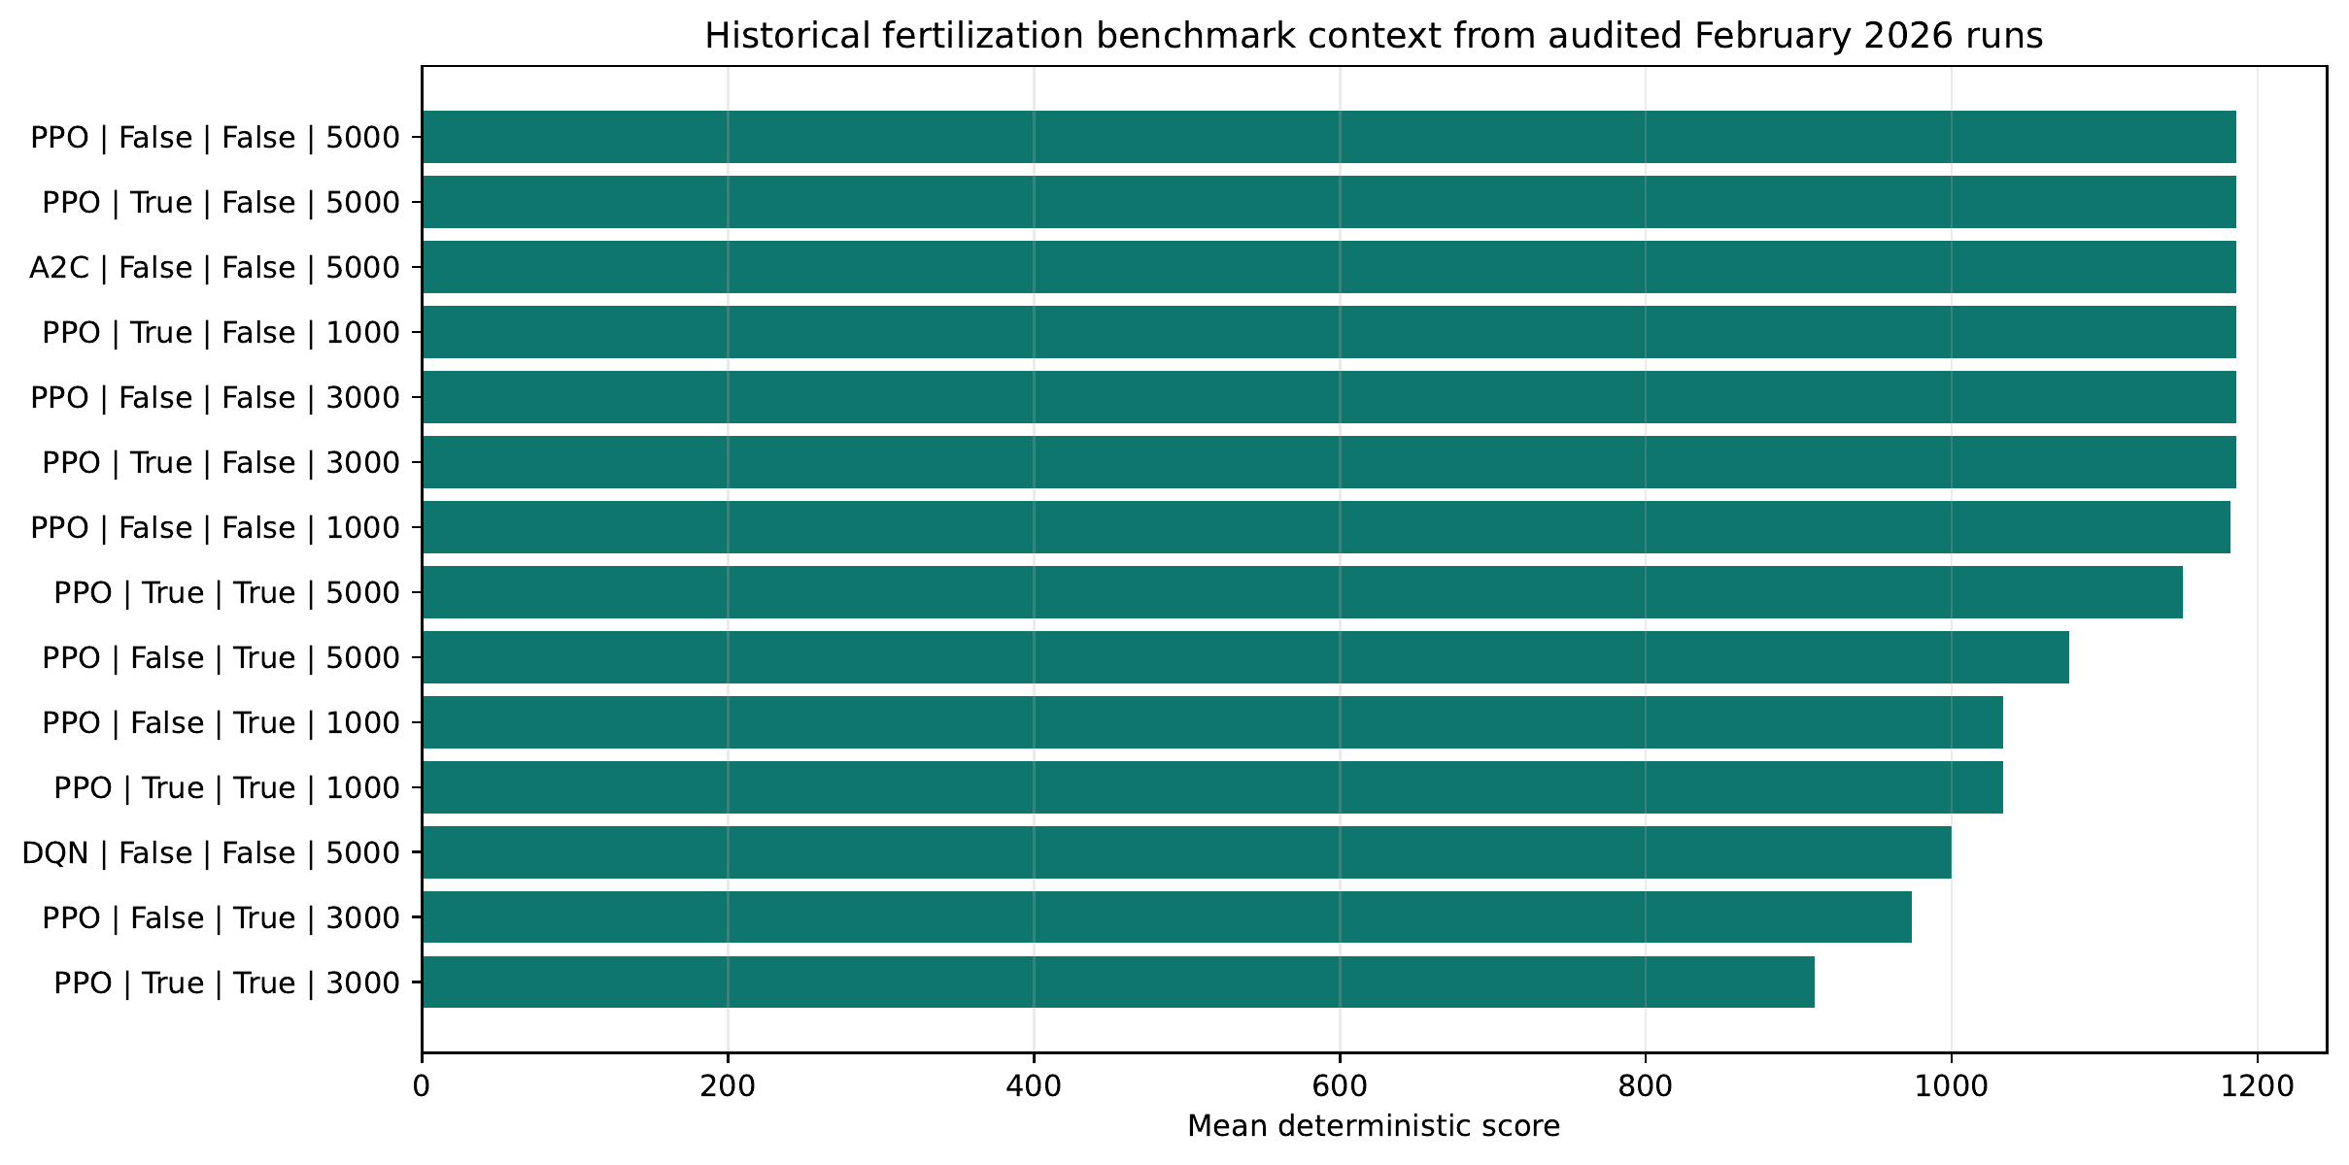
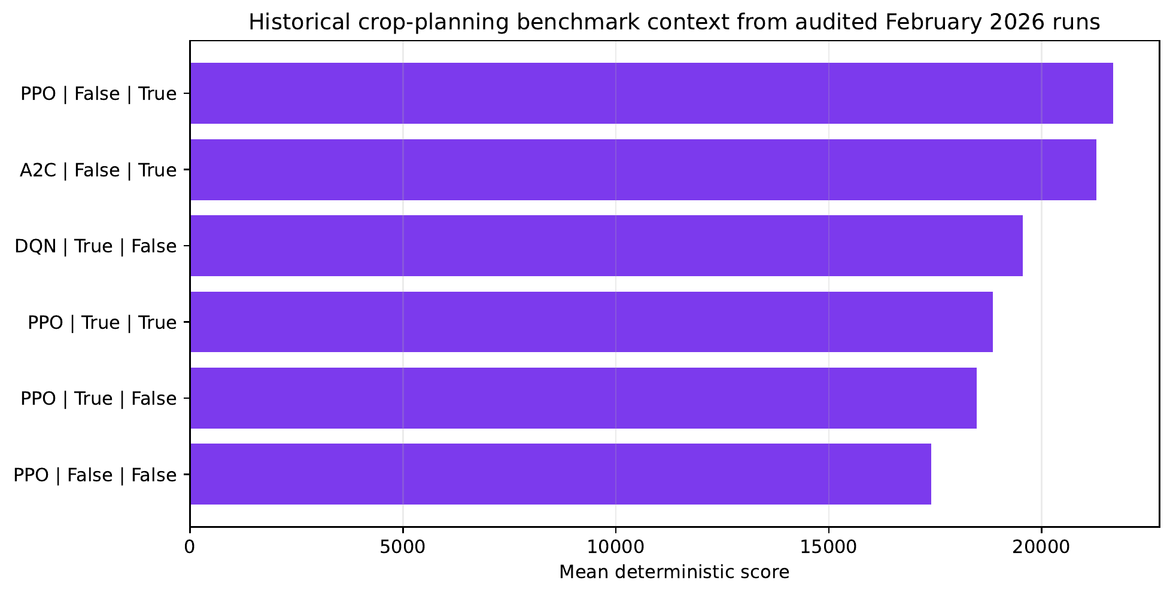
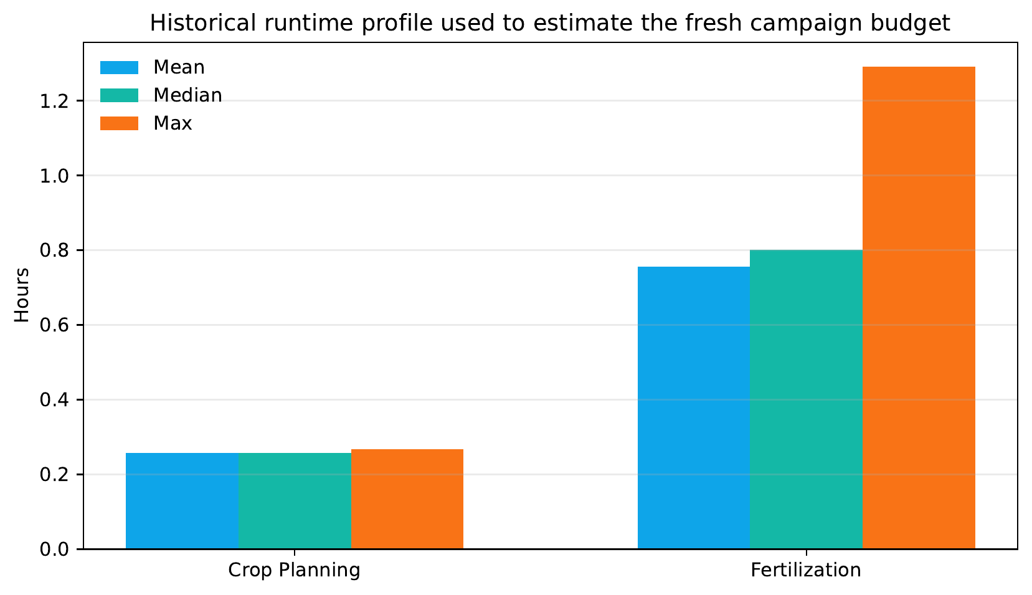
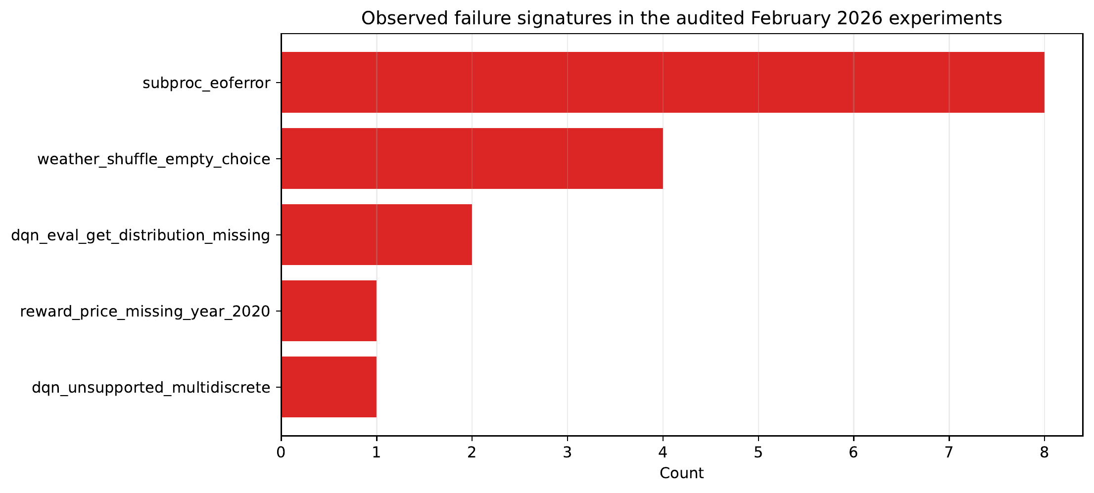
Historical Runs: Context, Not Canonical Final Pack
CONTEXT
Haider Masood | Process-Focused Defence Deck | March 2026
9

Slide 10
What Worked Well
OUTCOMES
Localization pipeline became coherent (weather, soil, yearly pricing).
NPK-aware reward and reporting integrated across modules.
Hierarchical environment implemented with report-rich outputs.
Verification discipline improved confidence (tests + smoke runs).
Thesis narrative became honest about implemented vs future scope.
Haider Masood | Process-Focused Defence Deck | March 2026
10

Slide 11
What Is Still Limited
GAPS
No field validation yet, so evidence remains simulation-bounded.
Irrigation as learned action still not implemented in active flow.
Rice-specific finalized localization/campaign is deferred.
Large matrix reruns are compute-intensive and expensive in wall-clock time.
Some old markdown and extracted-status notes had drift and needed correction.
Haider Masood | Process-Focused Defence Deck | March 2026
11

Slide 12
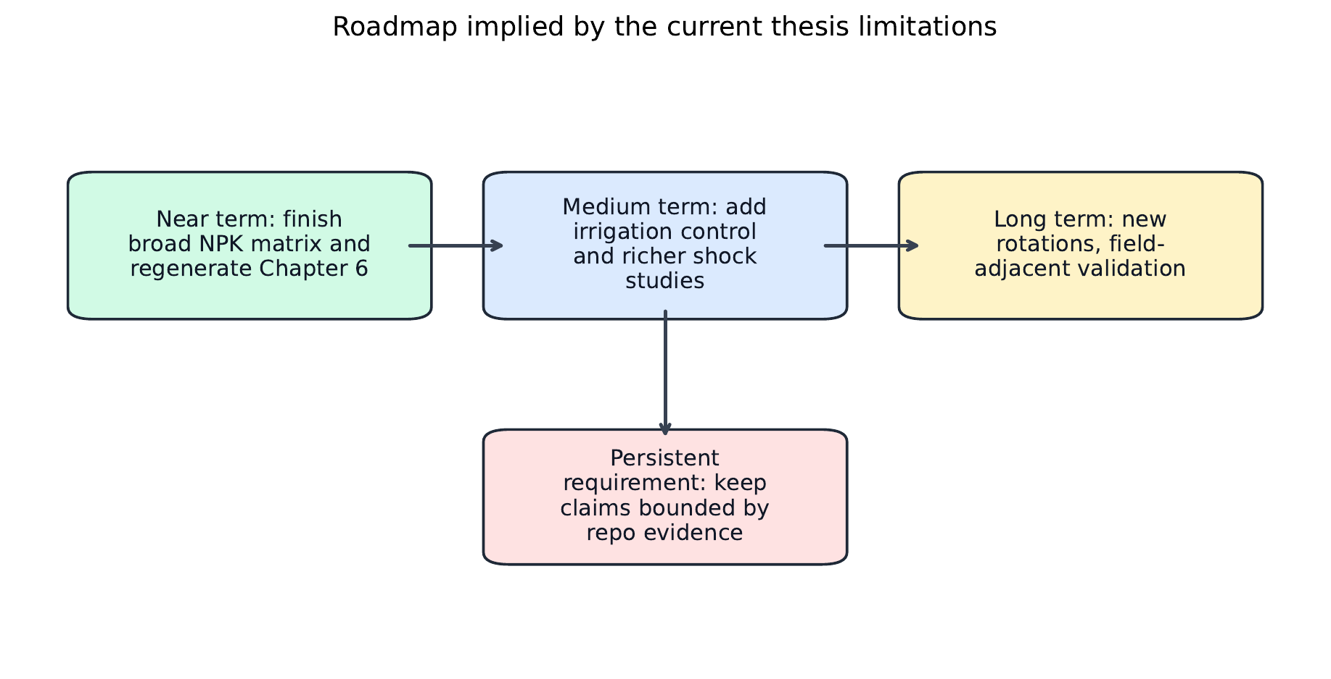
Next Steps Beyond Final Thesis Evidence
ROADMAP
Keep final_113 and final_42_ablation immutable as thesis evidence baselines.
Add irrigation/rice-focused experiments as post-thesis extension packs.
Document compute budgets and reproducibility scripts for reruns.
Plan field-adjacent validation with agronomy stakeholders.
Maintain strict implemented-vs-future claim boundaries.
Haider Masood | Process-Focused Defence Deck | March 2026
12

Slide 13
Repo Documentation Alignment Completed
DOCS
Active docs rewritten to match completed final frozen run status.
Stale 'pending fresh campaign' wording removed from active surfaces.
Added comprehensive noob guide: noobs_guide_to_the_whole_work.md.
Report markdowns aligned to final completed evidence packs.
Demo docs updated with thesis-boundary disclaimer and final status.
Haider Masood | Process-Focused Defence Deck | March 2026
13

Slide 14
Conclusion
CLOSING
Final Message
The core thesis engineering work is real, deep, and verified.
The evidence policy is intentionally strict to avoid over-claiming.
The comparative chapter is now supported by completed frozen runs (113 + 42).
Remaining work is post-thesis extension: irrigation, rice, and field validation.
Thank you
Questions?
Haider Masood | Process-Focused Defence Deck | March 2026
14

